Slide 1

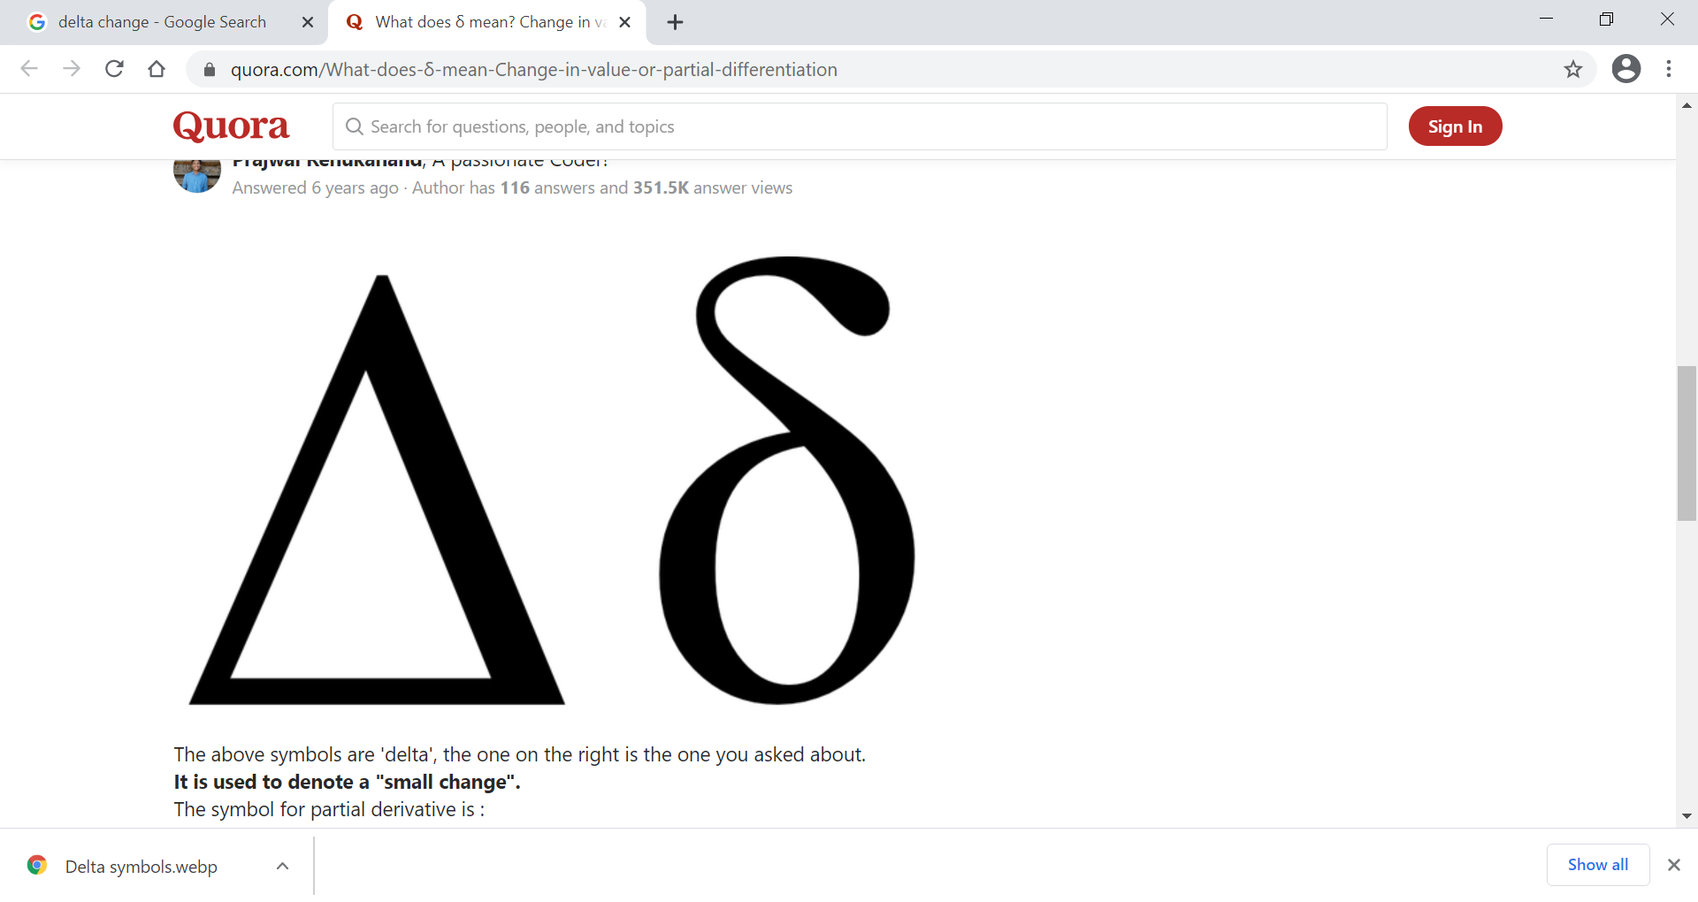
DΔnamic δoil Properties (DSP) January 26, 2020 Olympia Train, PI 11 Jason Nemecek Dynamic Soil Properties (DSP) Product Owner National Soil Data Applications Scientist
Science-driven - defensible - actionable
January 2021

Slide 2
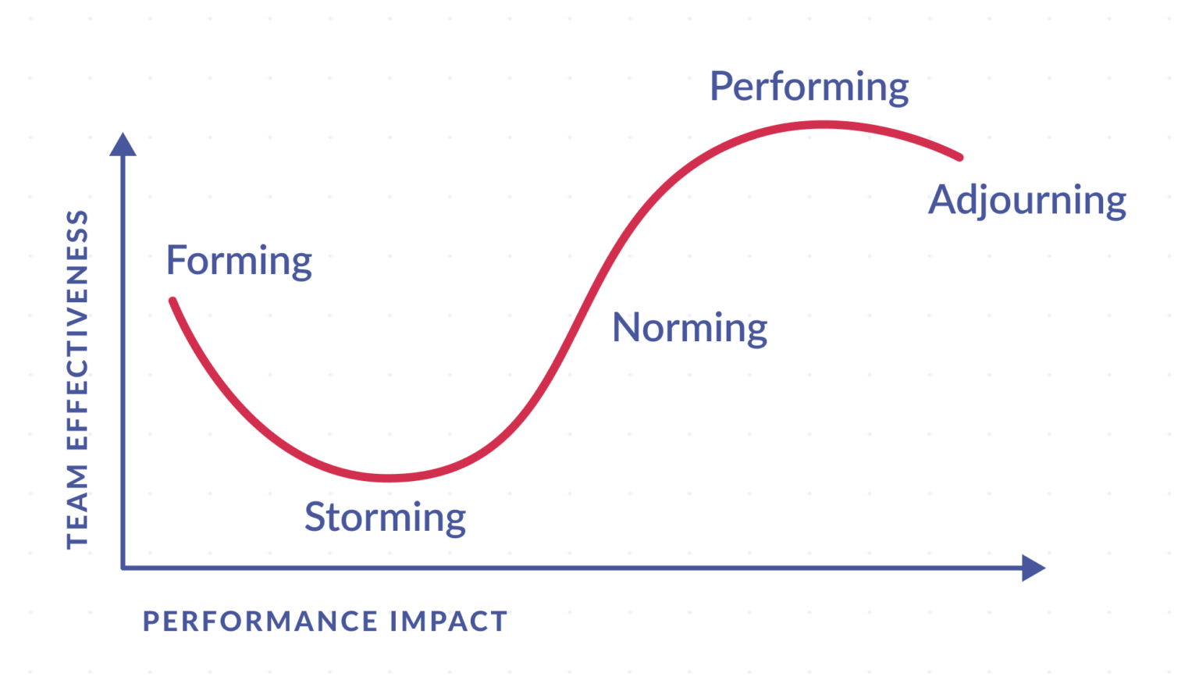
PI 0.5 – just barely kicking off
Where are we at?
Team was not fully formed
Scrum team has handled a lot of pivots during PI 11
Swarm work in 1st PI was very good
Each member contributed to multiple work areas
We are here

Slide 3


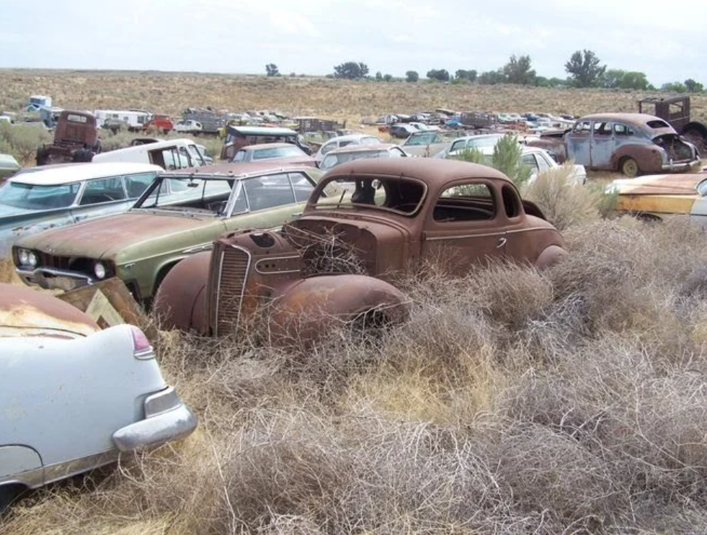
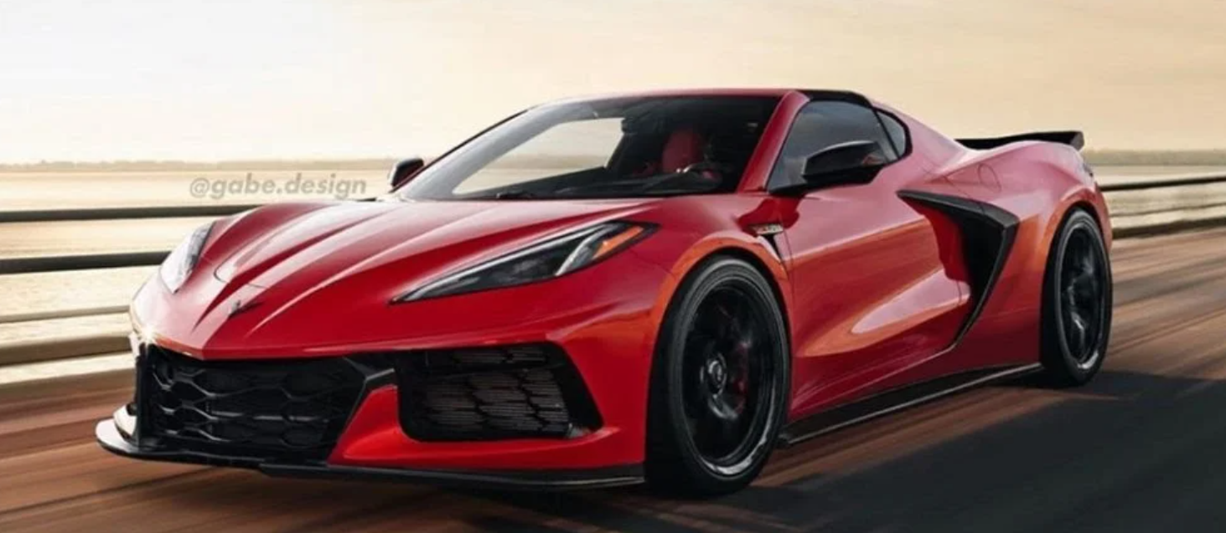
We established our design concept
High-end geospatial data science workbench
Versatile tools
Organized libraries for models and analytics
Skunkworks (Soil) Bench
future expansion?
Economists Bench
Water Bench
Carbon Bench

Slide 4
Strong progress
Accomplishments
NCSS development server resources in NITC
Draft Analysis of Alternatives (AoA) was produced with near and long-term platforms and analytics tools
Identification of dependencies with CIG, CPD, CART
Lifecycle requirements for authoritative data have been identified and draft process documented by architecture team
Good progress on identification/loading datasets
Data Maturity Management (DMM) efforts have started and include a starting a business glossary and a data dictionary

Slide 5
SHAPE Curves
Demo
Implemented a new soil data framework called “SHAPE”
SHAPE – Soil Health Analysis Protocol Evaluation
Ingests a soil carbon test result and provide a curve back as a decision-tool
Drafted code to pull all the relevant data from existing authoritative soil data libraries
Used Soil Lab Data as a proxy for CIG On Farm Soil Health Demonstration Trials data inputs

Slide 6
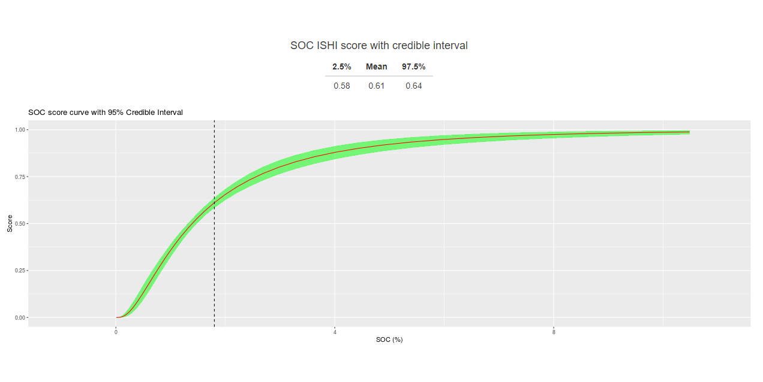
Demo

